Slide 1

FAULT TREE ANALYSIS Unit -4

Slide 2
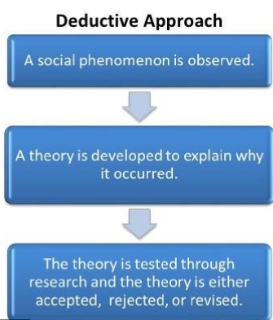
Introduction
Fault Tree Analysis was originally developed in 1962 at Bell Laboratories by H.A. Watson.
Originated in the aerospace industry and extensively used in nuclear power industry to qualify and quantify the hazards and risks
FTA is a deductive analysis approach for resolving an undesired event into its causes.
Logic diagrams and Boolean Algebra are used to identify the cause of the top event.

Slide 3
Contd…
A logic diagram called Fault tree is constructed to show the event relationship.
Probability of occurrence values are assigned to the lowest events in the tree in order to obtain the probability of occurrence of the top event.

Slide 4
Why F TA is Carried Out?
Identify the cause of a failure.
Monitor and control safety performance of a complex system.
To identify the effects of human errors .
Minimize and optimize resources.

Slide 5
The Fault Tree
Fault trees are a deductive method for identifying ways in which hazards can lead to accidents
The approach starts with well defined accident/top event and works backward toward the various scenarios that can cause the accident

Slide 6
The Fault Tree
Fault tree is the logical model of the relationship of the undesired event to more basic events.
The top event of the Fault tree is the undesired event.
The middle events are intermediate events
The basic events are at the bottom.
The logic relationship of events are shown by logic symbols or gates.

Slide 7
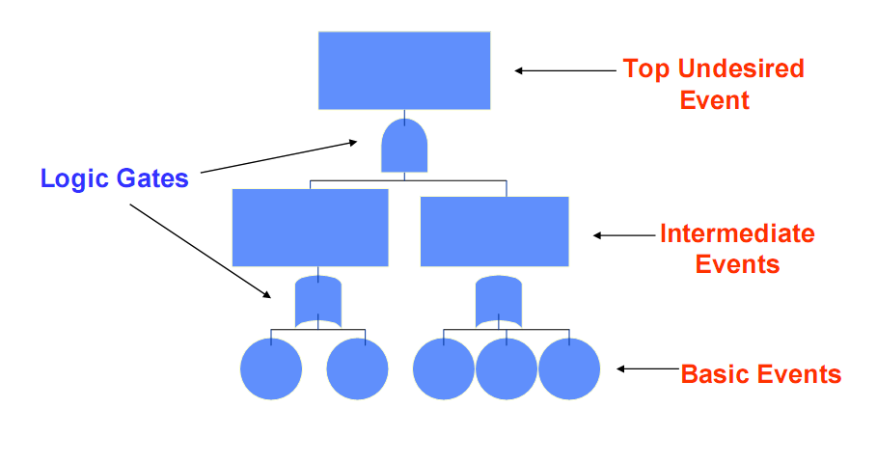
Basic Fault Tree Structure
Which can be defined
Which cannot be defined further

Slide 8
Events of a Fault tree
Basic Event: A lower most event that can not be further developed.
Intermediate Event: This can be a intermediate event (or) a top event. They are a result logical combination of lower
level events.
Undeveloped Event: An event which has scope for further development but not done usually because of insufficient data.
External Event: An event external to the system which can cause failure.

Slide 9
Basic Gates of a Fault tree
OR Gate: Either one of the bottom event results in the occurrence of the top event.
AND Gate: For the top event to occur all the bottom event should occur. (resulting output event requires simultaneous occurrence of all input events)
Inhibit Gate: The top event occurs only if the bottom event occurs and the inhibit condition is true.

Slide 10
Procedure
Procedure for Fault Tree Analysis
Define TOP event
Define overall structure.
Explore each branch in successive level of detail.
Perform corrections if required and make decisions
Solve the fault tree

Slide 11
Procedure
Define Top Event:
Use Preliminary hazard analysis (PHA), Process and Instrumentation Diagram (P&ID), Process description etc., to define the top event.
If its too broad, overly large FTA will result. E.g. Fire in process.
If its too narrow, the exercise will be costly. E.g. Leak in the valve.
The boundaries for top event definition can be a System, Sub-system, Unit, Equipment (or) a Function.
Some good examples are: Overpressure in vessel V1, Motor fails to start,
Reactor high temperature safety function fails etc.,

Slide 12
Procedure
Define overall structure:
Determine the intermediate events & combination of failure that will lead to the top event.
Arrange them accordingly using logical relationship

Slide 13
Procedure
Explore each branch in successive level of detail:
Continue the top down process until the root cause for each branch is identified and/or until further decomposition is considered unnecessary.
So each branch will end with a basic event or an undeveloped event.
Consider Common cause failure & Systematic failures in the process of decomposition.
A good guide to stop decomposing is to go no further than physical (or) functional bounds set by the top event.

Slide 14
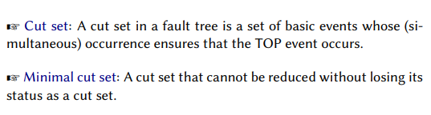
Procedure
Solve the Fault Tree:
Assign probabilities of failure to the lowest level event in each branch of the tree.
From this data the intermediate event frequency and the top level event frequency can be determined using Boolean Algebra and Minimal Cut Set methods.

Slide 15
Procedure
Minimal Cut Set theory:
The fault tree consists of many levels of basic and intermediate events linked together by AND and OR gates. Some basic events may appear in different places of the fault tree.
The minimal cut set analysis provides a new fault tree, logically equivalent to the original, with an OR gate beneath the top event, whose inputs (bottom)are minimal cut sets.
Each minimal cut set is an AND gate with a set of basic event inputs necessary and sufficient to cause the top event.

Slide 16
Procedure
Perform corrections and make decisions:
Application of Boolean Algebra and Minimal Cut Set theory will result in identifying the basic events(A) and combination of basic events(B.C.D) that have major influence on the TOP event.
This will give clear insight on what needs to be attended and where resources has to be put for problem solving.

Slide 17

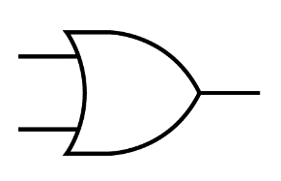

Example
AND gate: resulting output event requires the simultaneous occurrence of all input events
Top event
Flat Tire
2 contributing causes
Basic or intermediate events
OR
OR gate:
a logical operation which gives the value one if at least one operand has the value one, and otherwise gives a value of zero
Tire Failure
Road Debris
OR gate means the resulting output event requires the occurrence of any individual input event
OR
Defective Tire
Worn Tire

Slide 18
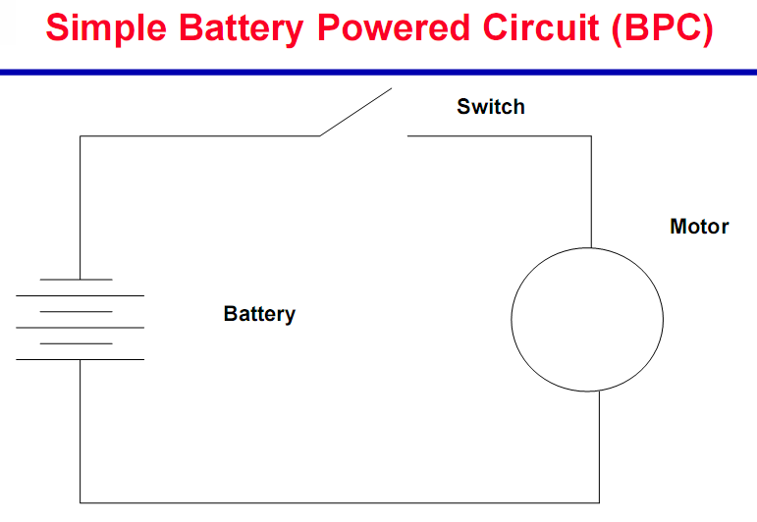
Example

Slide 19
Specifications for the BPC FT
Undesired top event : Motor does not start when switch is closed.
Boundary of the FT : The circuit containing the motor, battery, and switch.
Resolution of the FT: The basic components in the circuit excluding the wiring.
Initial State of System: Switch open, normal operating conditions.

Slide 20
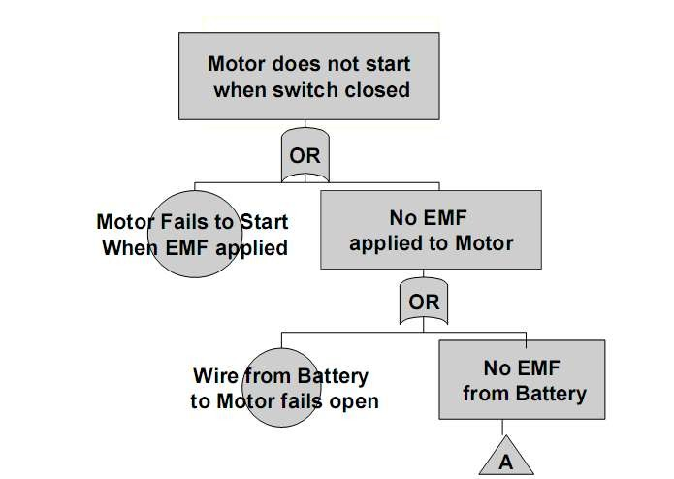
Start of BPC FT (1)

Slide 21
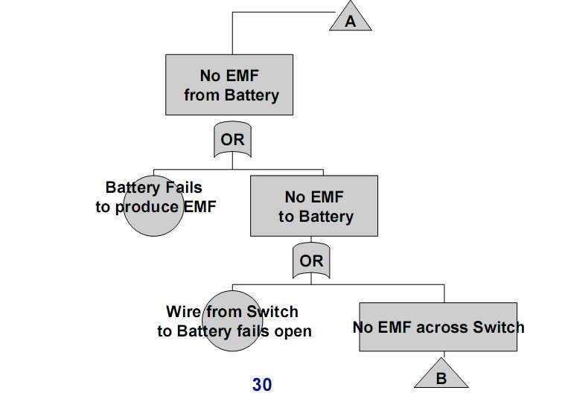
Start of BPC FT (2)

Slide 22
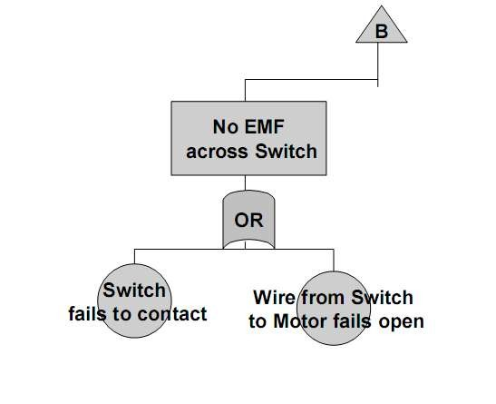
Start of BPC FT (3)

Slide 23
Procedure
Define the primary failure to be analyzed in other words identify the undesirable top event
Identify first level contributors which are just below the top level using the available technical information
Link these contributors to top level event by using logical gates (AND, OR gates), and also see the relationship, so that it will help to identify the appropriate logical gate
Identify the second level contributors and link to top by using logical gates.
Identify minimal cut set
Repeat the same steps till the basic causes
Finally complete and evaluate the FTA
Calculate probability of lowest level elements occurrence and also measure the probabilities from bottom up

Slide 24
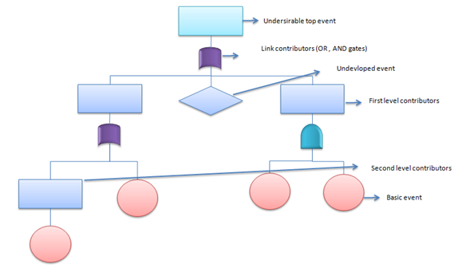

Slide 25
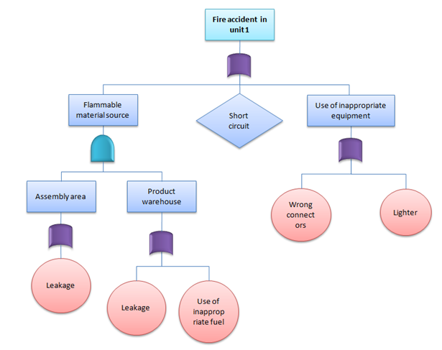
Practical Example of FTA
A fire broke out at unit 1 of XYZ cable manufacturing company despite safety system in-place. General Manager was very concern about the accident and requests safety in-charge to evaluate the system. However as part of initial analysis of the existing system, safety team using FTA to identify the different causes for accident.

Slide 26
Advantages of FTA
Deals well with parallel, redundant or alternative fault paths.
Searches for possible causes of an end effect which may not have been foreseen.
The cut sets derived in FTA can give enormous insight into various ways top event occurs.
Very useful tool for focused analysis where analysis is required for one or two major outcomes.

Slide 27
Disadvantages of FTA
Requires a separate fault tree for each top event and makes it difficult to analyze complex systems.
Fault trees developed by different individuals are usually different in structure, producing different cut set elements and results.
The same event may appear in different parts of the tree, leading to some initial confusion.

Slide 28
Applications
Used in the field of safety engineering and Reliability engineering to determine the probability of a safety accident or a particular system level failure.
Aerospace Engineering.
https://www.youtube.com/watch?v=l-zZkid-i0Q

